Slide 1

Digital marketing project

Slide 2
CONTENTS
INTRODUCTION OF BRITANNIA
VISION AND MISSION OF BRITANNIA
HISTORY
FOUNDERS
STRATEGIES OF BRITANNIA
SWOT ANALYSIS OF BRITANNIA
OVERVIEW OF BRITANNIA

Slide 3
PRESENTED BY
K.PAVITHRA
J.RAGHAVENDRA
K.DINESH KUMAR
K ESWAR

Slide 4
REASEARCH BRAND : BRITANNIA
INTRODUCTION OF BRITANNIA
Britannia industries is one of India's leading food companies with a 100 year legacy and annual revenues in excess of Rs.9000cr .
Britannias product portfolio includes biscuits , bread cakes , rusk and diary products including cheese beverages , milk and yoghurt .
Britannia is a brand which may generations of Indians grown up with and cherished and loved in India and world over.

Slide 5
vision
Expanding their global client base with significant repeat businesses
A flexible and innovative approach towards the needs of their clients aware of emerging trends and technological breakthroughs.
Being able to communicate effectively and knowledgeably in the diverse range of countries in which we operate.

Slide 6
mission
To meet or where possible exceed the expectation of our diverse client base with flexible innovative solutions of the highest quality that adhere to safe ethically sound and environmentally friendly codes of practice.

Slide 7
History of Britannia
In the year 1891 , a group of british businessmen formed a company in a room of small house in kolkata with Rs 295.
And now , 130 years later , that company is one of the biggest FMCG companies in India.
Just as recently as november 2022 , Britannia's shares zoomed to all-time growth in the June-September quarter , which resultes in Britannia entering the Rs 1 trillion market value club.

Slide 8
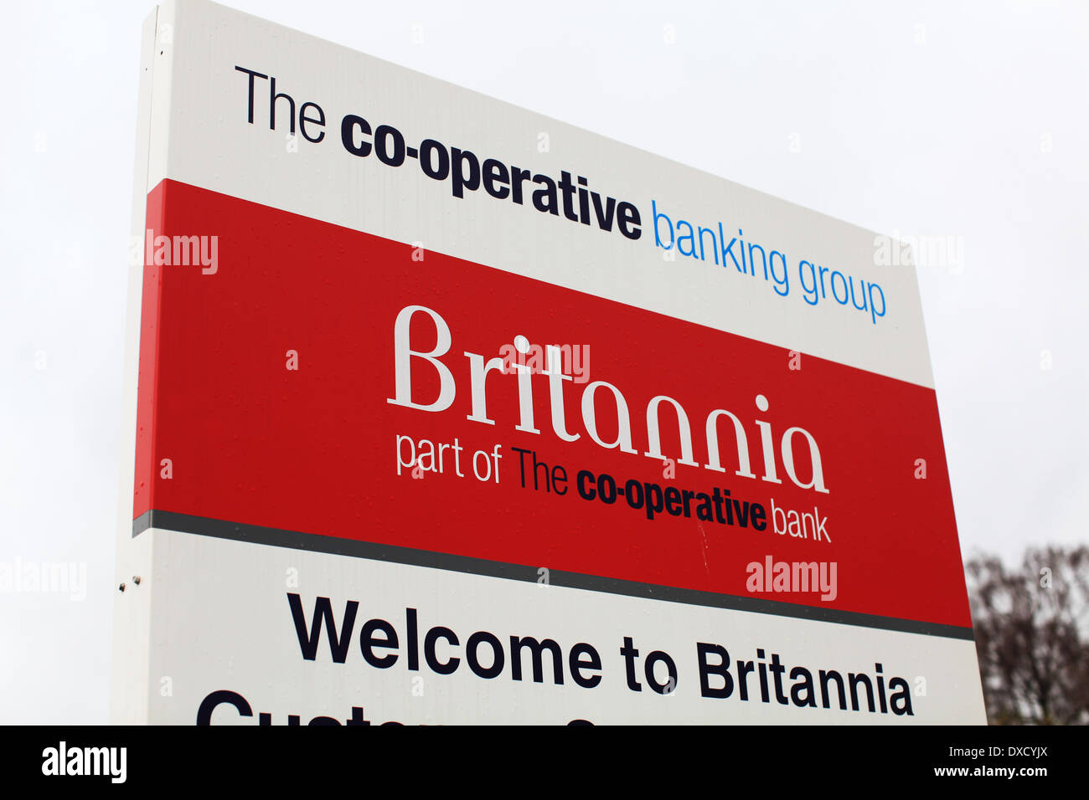
cooperative model
The deal take advantage of new legislation that is likely to spark sweeping consolidation among britain's 55 building societies , 33 mutual insurers and 70 friendly societies.

Slide 9
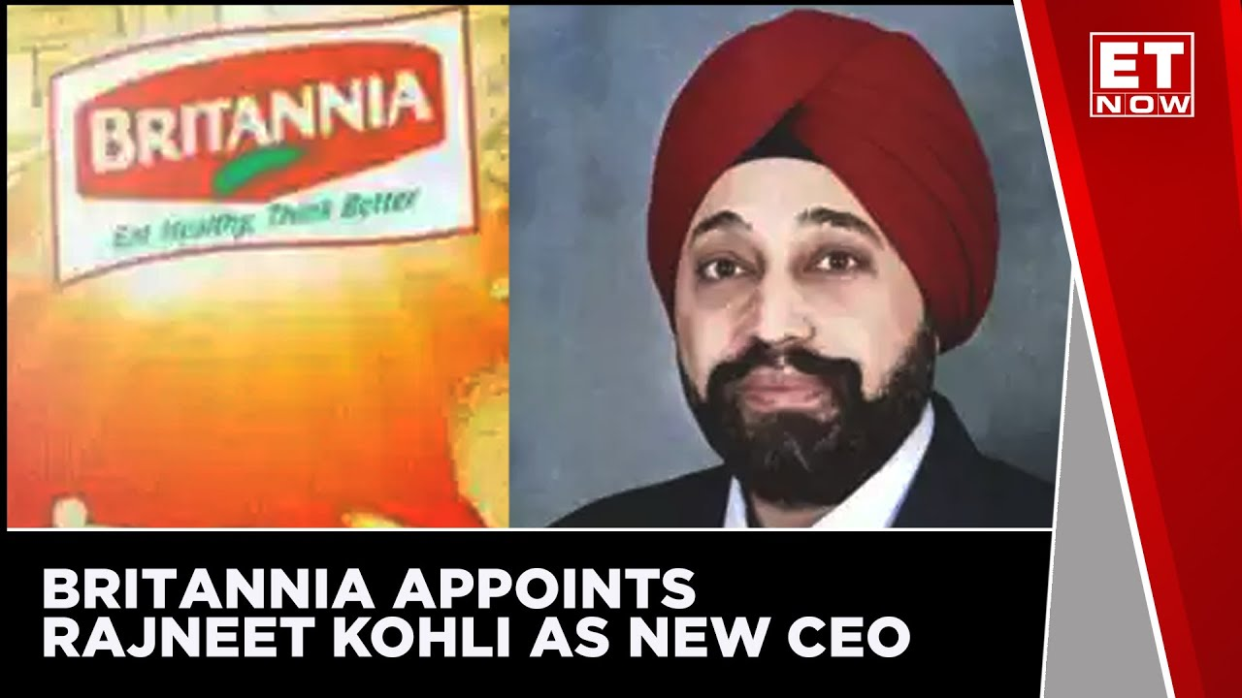
CEO of Britannia

Slide 10
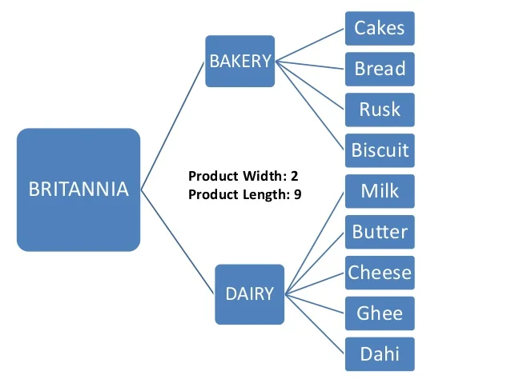
product range of Britannia
Britannia's product strategy
comprises mostly,cakes,
biscuits,breads,and rusk in
its marketing mix.

Slide 11
product line of Britannia
Britannia's products can be classified as non durables/tangible.
Britannia often offers some of its biscuits in bundles and provides a discount on them.
Britannia in order to differentiate its products recently changed the packaging of almost all of its biscuits.it improved the quality and made the packaging more colorful and attractive.

Slide 12
short goals
At Britannia , they are committed to delivering, exciting goodness to their consumers. The department plays a key role in achieiving this objective by developing products that are not only delicious but also healthy and nutritious.
The company also looking to expand its sales and distribution network in the Northern and western states besides increasing its sales in rural areas.

Slide 13
overview of Britannia
Britannia industries is one of the India's leading food companies with a 100 year legacy and annual revenues in excess of Rs.9000cr.
Britannia is among the most trusted food brands and manufactures India's favorite brands like Good day , Tiger , Nutrichoice , Milk bikis , and Marie gold which are household names in India.

Slide 14
competitors of Britannia
The top competitors of Britannia include ;
cookie man India-chennai based , 2000 founded, acquired company.
Loyka-Mumbai based, 2017 founded , seed company.
The bread company-Delhi based , 1809 found, seed company.
marino-Hyderabad based, 2015 founded , unfunded company.
sunfeast-Bengaluru based, 2003 founded , unfunded company.
Baker street-Mumbai based , 2011 founded, series a company.

Slide 15
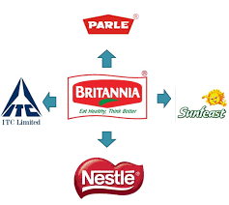
key words of competitors

Slide 16
Digital strategy
Britannia's social media strategy ;
Britannia's digital marketing strategies have effectively utilized various online platforms to engage with their audience.
Through social media channels like Facebook , Instagram , and Twitter , Britannia has created online presence and interacted with consumers in a personalized and engaging manner.

Slide 17
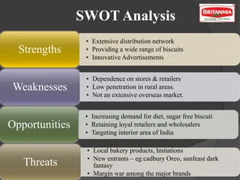
SWOT analysis of Britannia

Slide 18
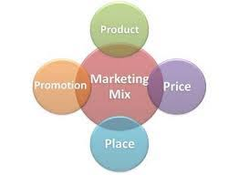
Strategies of Britannia
Britannia's marketing and branding strategies;
marketing strstegy of Britannia and social
media compaigns are more focused on the
connecting taste,nutrition, and movements of
life.
Britannia also focused on new product
development and promoting nutrition and health.

Slide 19
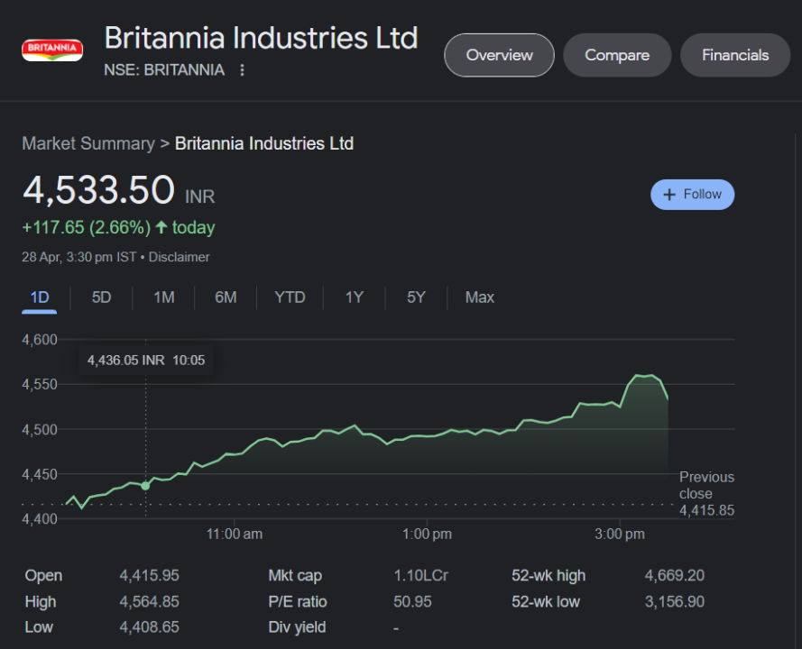
Key performance of Britannia

Slide 20
Social media engagement
To inspire people to celebrate the seemingly small, everyday moments of joy without waiting for the big , momentous occassions.
Britania uses social media to connect with customers and boost brand visibility.
content marketing helps Britannia educate and promote its products.
SEO tactics help Britannia rank higher in search results and attract more online visitors.

Slide 21
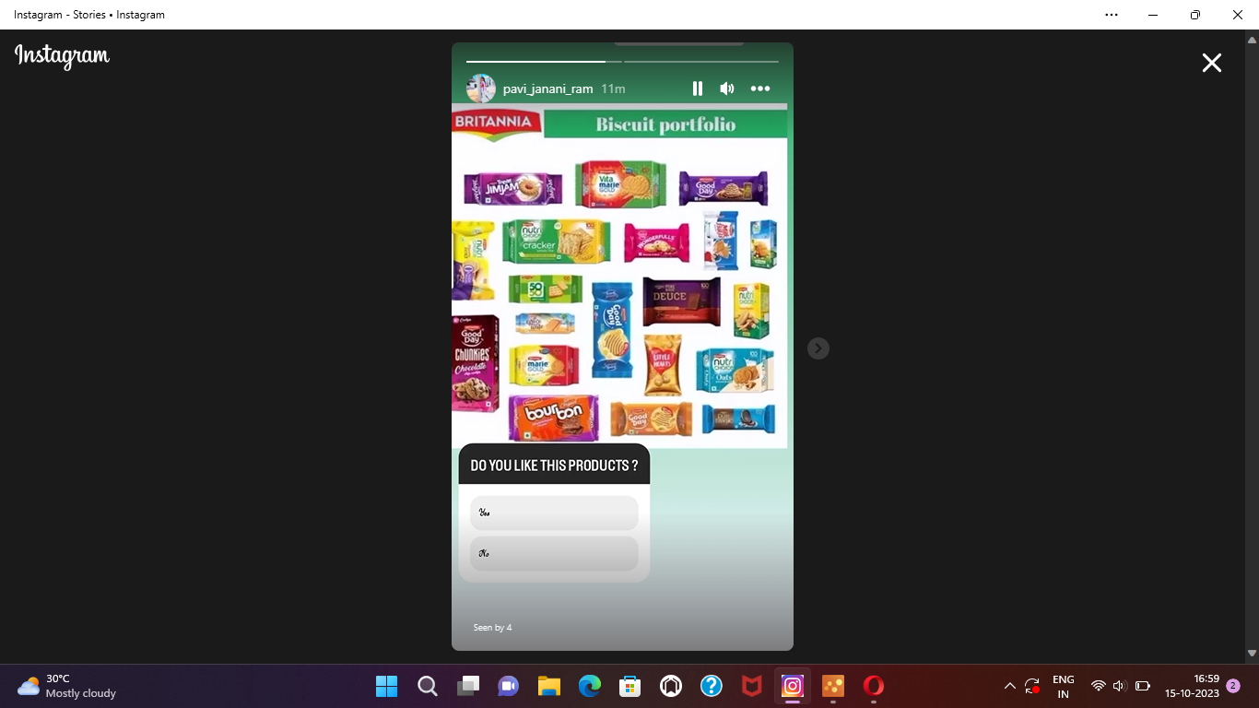
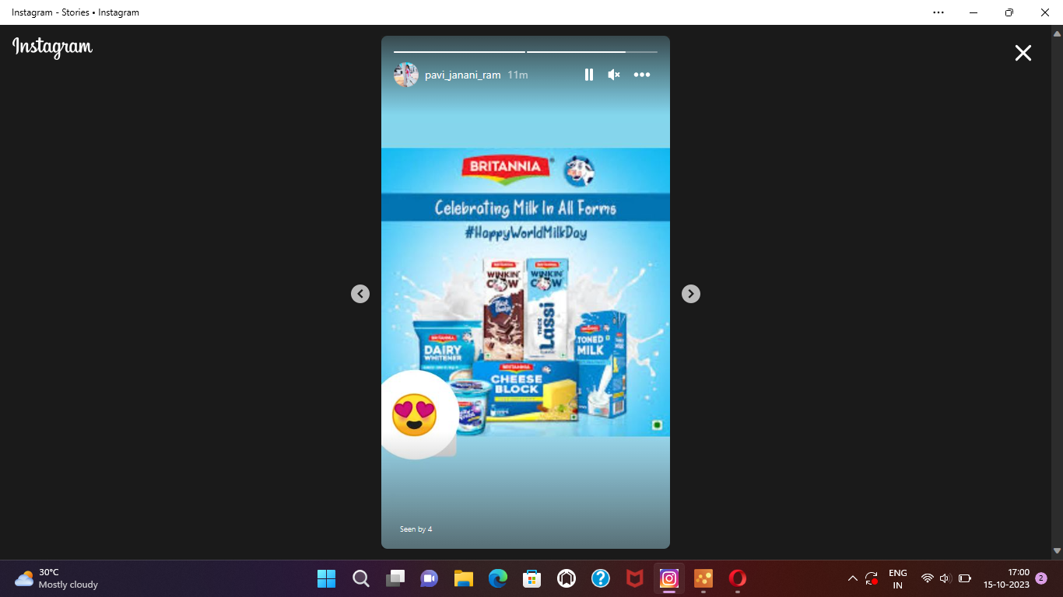
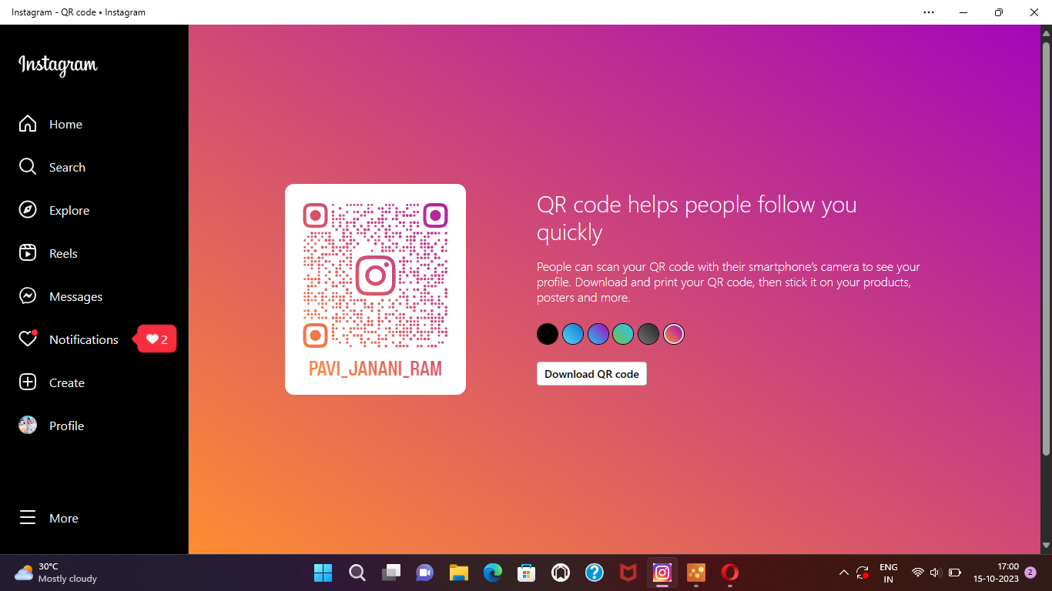
Instagram

Slide 22
Instagram story link
https://instagram.com/stories/pavi_janani_ram/3214084394013381590?utm_source=ig_story_item_share&igshid=NDA3YzJlZDM2MQ==
https://instagram.com/stories/pavi_janani_ram/3214084026131021180?utm_source=ig_story_item_share&igshid=NDA3YzJlZDM2MQ==

Slide 23

K.Pavithra
~ Team leader
Myself K.Pavithra , the team leader of this team . I assigned the works to my team members based on their skills and interest. I supervised and helped in all their works , and I collected some information .and I also edited this ppt.

Slide 24

J.Raghavendra
~team member
I focused on my team objective with lots of dedication about the project work presentation . i have prepared instagram stories for ppt.

Slide 25
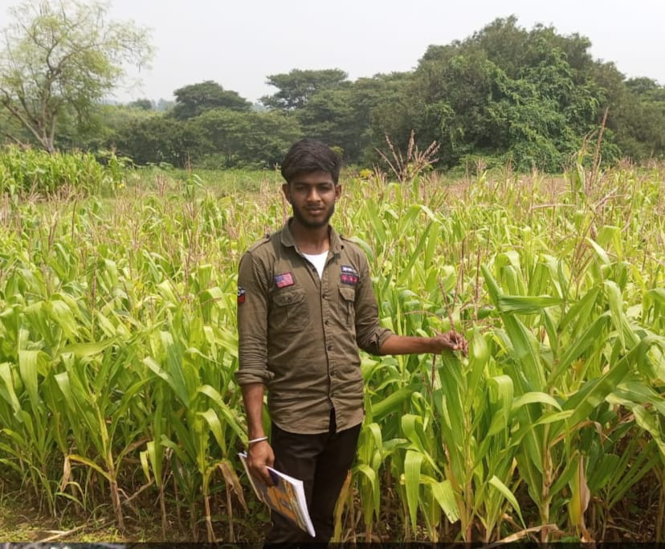
K.dinesh kumar
~team member
I edited the ppt with the help of my team. and i played a vital role to complete our project.

Slide 26
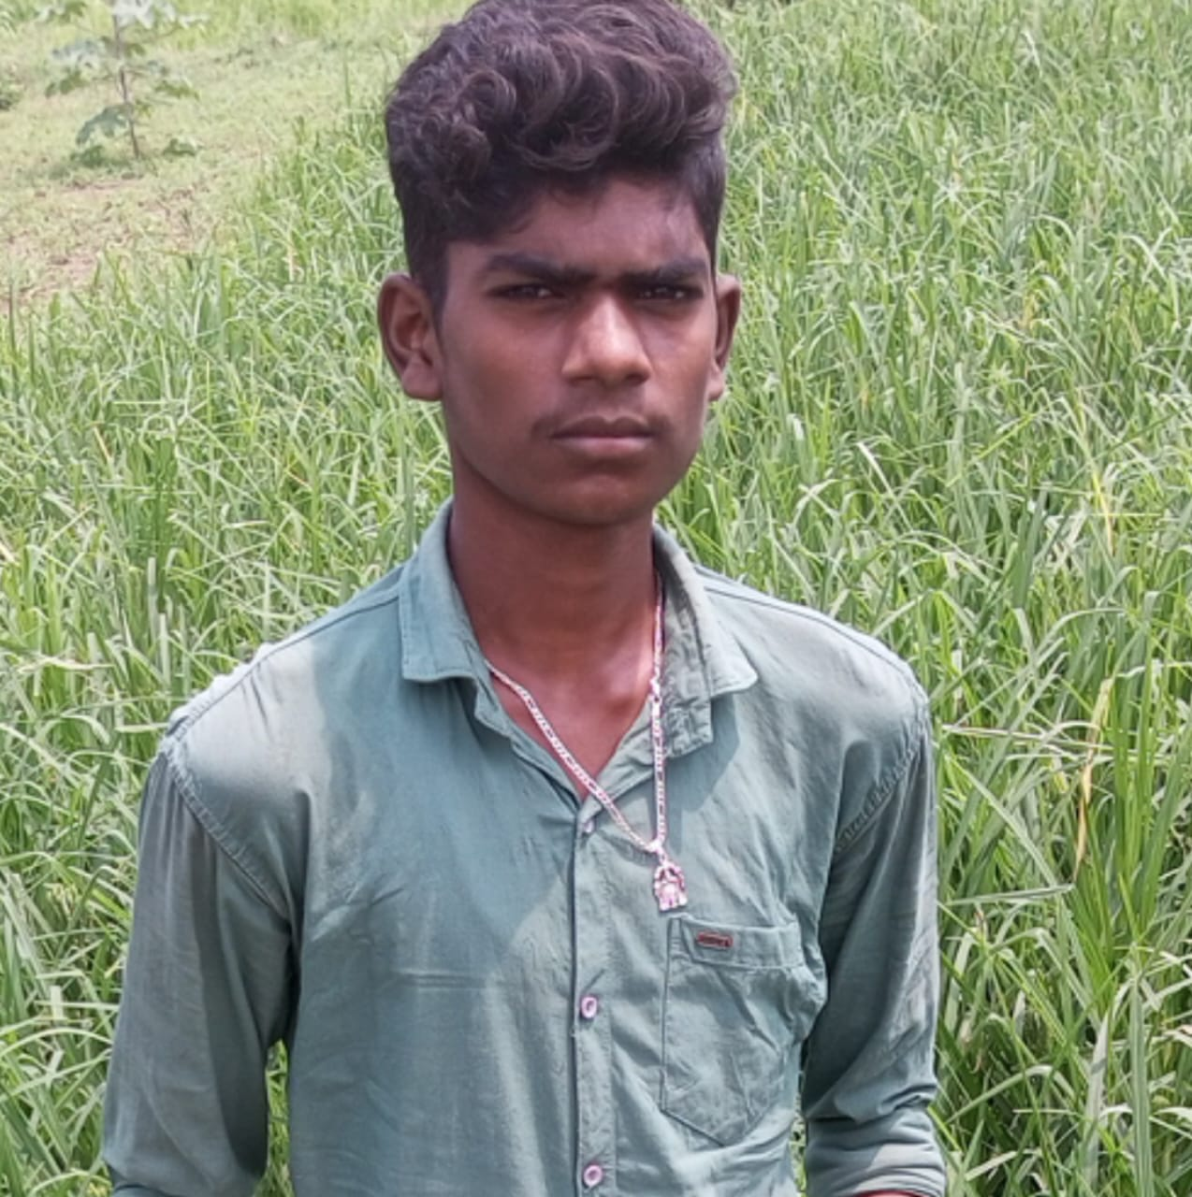
K.Eswar
~team member
I have motivated my team to complete out our project more efficiently.
THANK YOU....

